Slide 1

CITY OF HARRISONBURG, VIRGINIA
DEPARTMENT OF PUBLIC UTILTIES
LONG TERM FINANCIAL MODELS (LTFM)
FY2025
December 1, 2024

Slide 2
HARRISONBURG, VIRGINIA
LONG TERM FINANCIAL MODEL
Harrisonburg Public Utilities, as typical to our industry, faces a dichotomy that requires balancing affordability versus sustainability. As we address affordability, we consider which customers impact our costs and we consider how our rates affect customer budgets. As we address sustainability, we plan our agenda for retiring and replacing our infrastructure assets (valued at $900M in FY2025).
Our Long-Term Financial Model (LTFM) is our tool that allows for the vision to be consolidated and communicated in the journey for success.

Slide 3
HARRISONBURG, VIRGINIA
LONG TERM FINANCIAL MODEL
What does our FY2025 model tell us?
Continuing forward with our current water rates as in effect in FY2025, we forecast a shortfall in funding of $4.3M in 2026 and growing to a cumulative $55.6M by 2035. Sewer rates created a similar forecasted shortfall of $1.6M in 2026 and a cumulative $25.0M by 2035.
How have we used the model to provide a strategy?
Without a recovery strategy, “kicking the can down the road” for infrastructure funding is a common but very risky maneuver for any utility. Whereas our current rates will not sustain our infrastructure needs, interjecting affordability requires us to kick the can, but in our strategy, we will recover to full funding over a 25-year period. Our asset management strategy is key to mitigating the risk that we will incur during our recovery period.

Slide 4
LONG TERM FINANCIAL MODELS
STRATEGY FY2026+
WATER LTFM
2026-2029 5.0% rates---$13.0M deferred
2030-2031 4.0% rates---$18.0M deferred
3.0% rates---$20.0M deferred
2032-2037 2.5% rates---$29.0M deferred
2038-2050 2.5% rates---$ 0.0M deferred
SEWER LTFM
2026-2027 4.0% rates---$0.0M deferred
2028-2030 4.0% rates---$0.0M deferred
-2050 2.5% rates---$0.0M deferred
With a progressive approach to apply the LTFM percentage increases uniformly across all existing customers (pre-affordability analysis) , HPU monthly billing for 5,000 gallons water & sewer would increase from $50.90 in FY2025 to $66.70 in FY2032. An increase but does not yet reach the 2022 statewide average at $92.04.

Slide 5
WATER LONG TERM FINANCIAL MODEL
(WLTFM)

Slide 6

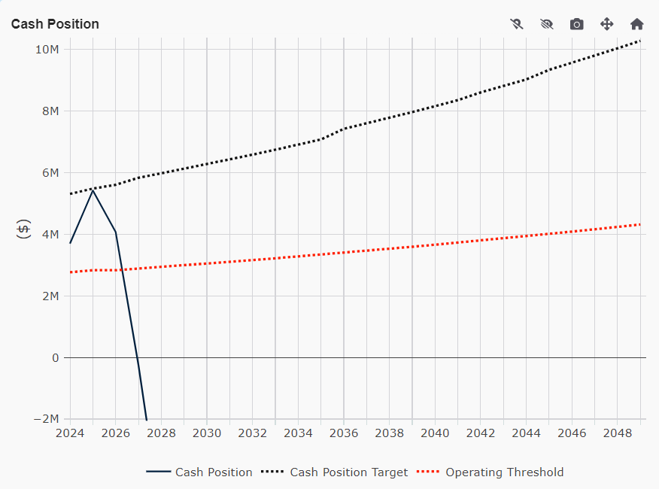
WATER LONG TERM FINANCIAL MODEL
(WLTFM) STRATEGY
WATER FUND BALANCE EOFY 2024 $ | WATER CASH SALES EOFY 2024 $ | FUND BALANCE / CASH SALES (25% Target)
$5,419,496 | $10,804,646 | 50.2%
FY2025 water rates cannot support the capital that is needed to replace assets.
The funding shortfalls for 1 yr, 3 yrs, 5 yrs and 10 yrs are as shown in the table
FUND BALANCE CASH POSITION
WATER OUTLOOK | 2026 | 2026-2028 | 2026-2030 | 2026-2035
Revenue $ | $20,925,000 | $45,407,134 | $70,758,302 | $155,454,203
Expenses $ | $25,257,083 | $59,811,809 | $95,471,015 | $211,049,904
DEFICIT $ | $4,332,084 | $14,404,674 | $24,712,712 | $55,595,700

Slide 7
WATER LONG TERM FINANCIAL MODEL
(WLTFM) STRATEGY
EOFY2024 FUND BALANCE = $5,419,496
EOFY2025 FUND BALANCE = $3,119,496
LOWER THRESHOLD 25% = $2,960,000
Fund balance will reduce by $2.4M in FY2025 but will remain above the threshold
SALES GROWTH = 1.90% / YR.
-$1,300,000 PER FY2025 BUDGET
and
$1,000,000 TRANSFER TO CIP FOR DESIGN OF DRI & NRI SCREENS
NON-SALES REVENUE = $605,000 / YR.
EXPENSE INFLATION = 5.0% / YR.
CAPITAL ACSO = $5,487,882+ / YR.-- CIP
CAPITAL EXPANSION BY DEBT $42M

Slide 8
WATER LONG TERM FINANCIAL MODEL
(WLTFM) STRATEGY
EOFY2024 FUND BALANCE = $5,419,496
EOFY2025 FUND BALANCE = $3,119,496
LOWER THRESHOLD 25% = $2,960,000
A sales growth of 1.9% is forecasted.
SALES GROWTH = 1.90% / YR.
NON-SALES REVENUE = $605,000 / YR.
EXPENSE INFLATION = 5.0% / YR.
CAPITAL ACSO = $5,487,882+ / YR.-- CIP
CAPITAL EXPANSION BY DEBT $42M

Slide 9
WATER LONG TERM FINANCIAL MODEL
(WLTFM) STRATEGY
EOFY2024 FUND BALANCE = $5,419,496
EOFY2025 FUND BALANCE = $3,119,496
LOWER THRESHOLD 25% = $2,960,000
This non-sales revenue is volatile in historic trending, and we therefore forecast $605,000 per year with zero inflation.
SALES GROWTH = 1.90% / YR.
NON-SALES REVENUE = $605,000 / YR.
EXPENSE INFLATION = 5.0% / YR.
CAPITAL ACSO = $5,487,882+ / YR.-- CIP
CAPITAL EXPANSION BY DEBT $42M

Slide 10
WATER LONG TERM FINANCIAL MODEL
(WLTFM) STRATEGY
EOFY2024 FUND BALANCE = $5,419,496
EOFY2025 FUND BALANCE = $3,119,496
LOWER THRESHOLD 25% = $2,960,000
SALES GROWTH = 1.90% / YR.
NON-SALES REVENUE = $605,000 / YR.
EXPENSE INFLATION = 5.0% / YR.
CAPITAL ACSO = $5,487,882+ / YR.-- CIP
We forecast a 5.0% per year operating expense inflation.
CAPITAL EXPANSION BY DEBT $42M

Slide 11
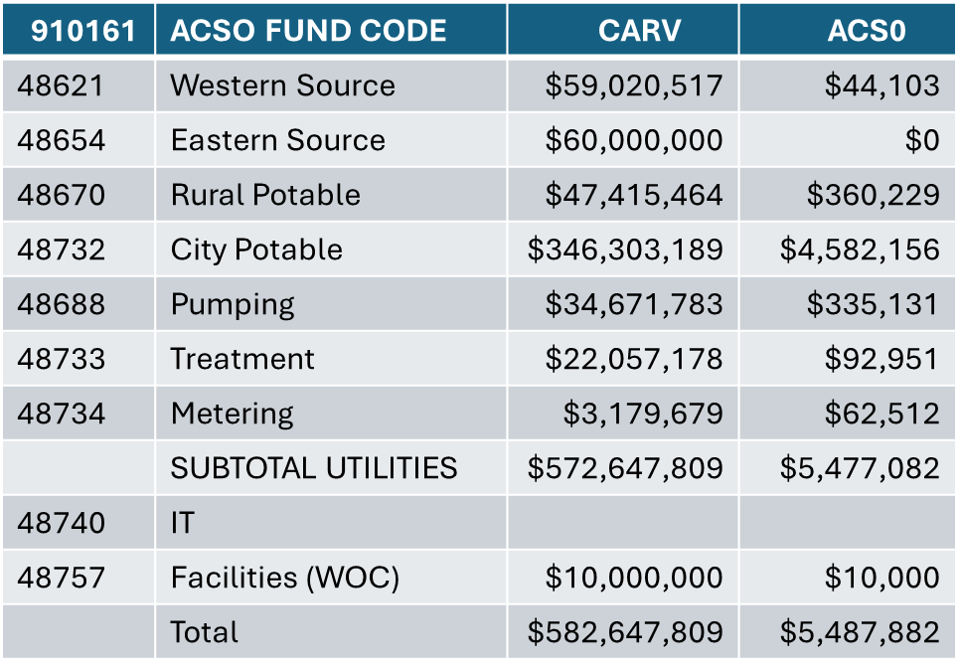
WATER LONG TERM FINANCIAL MODEL
(WLTFM) STRATEGY
EOFY2024 FUND BALANCE = $5,419,496
EOFY2025 FUND BALANCE = $3,119,496
LOWER THRESHOLD 25% = $2,960,000
ADD:
$50k / YR MAIN EXTENSIONS
$300K –WRWL THRU 2034
$100K – WOC THRU 2034
SALES GROWTH = 1.90% / YR.
NON-SALES REVENUE = $605,000 / YR.
EXPENSE INFLATION = 5.0% / YR.
CAPITAL ACSO = $5,487,882+ / YR.-- CIP
We forecast $5,937,082 per year needs in capital less $500K per year in contributions made from construction.
CAPITAL GROWTH BY DEBT $42M

Slide 12
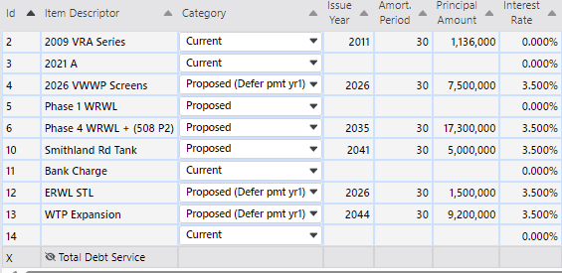
WATER LONG TERM FINANCIAL MODEL
(WLTFM) STRATEGY
EOFY2024 FUND BALANCE = $5,419,496
EOFY2025 FUND BALANCE = $3,119,496
LOWER THRESHOLD 25% = $2,960,000
SALES GROWTH = 1.90% / YR.
NON-SALES REVENUE = $605,000 / YR.
EXPENSE INFLATION = 5.0% / YR.
CAPITAL ACSO = $5,487,882+ / YR.-- CIP
DEBT FORECASTING
$ 9.0M BOND DRI & NRI SCREENS
2035 $17.3M BOND WESTERN RAW WATERLINE
$ 5.0M BOND SMITHLAND ROAD TANK
2044 $ 9.0M BOND WTP EXPANSION
CAPITAL GROWTH BY DEBT $42M

Slide 13
WATER LONG TERM FINANCIAL MODEL
(WLTFM) STRATEGY
EOFY2024 FUND BALANCE = $5,419,496
EOFY2025 FUND BALANCE = $3,119,496
LOWER THRESHOLD 25% = $2,960,000
RATE ADJUSTMENT
2026-2029 | 5.0 % / YR.
2030-2031 | 4.0% / YR.
2032 | 3.0% / YR.
2033+ | 2.5% / YR.
DEFER CAPITAL $
2026-2027 | -$3,500,000 / YR.
2028-2029 | -$3,000,000 / YR.
2030-2031 | -$2,500,000 / YR.
2032-2033 | -$2,000,000 / YR.
2034-2035 | -$1,500,000 / YR.
2036-2037 | -$1,000,000 / YR.
2038-2039 | +$1,000,000 / YR.
2040-2041 | +$1,500,000 / YR
2042-2043 | +$2,000,000 / YR.
2044-2045 | +$2,500,000 / YR.
2046-2047 | -$3,000,000 / YR.
2048-2049 | -$3,500,000 / YR.
SALES GROWTH = 1.90% / YR.
NON-SALES REVENUE = $605,000 / YR.
EXPENSE INFLATION = 5.0% / YR.
CAPITAL ACSO = $5,487,882+ / YR.-- CIP
CAPITAL GROWTH BY DEBT $42M

Slide 14
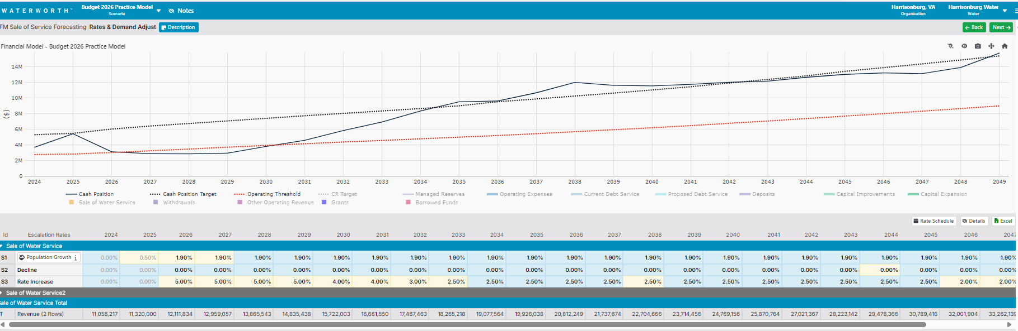
WATER LONG TERM FINANCIAL MODEL
(WLTFM) STRATEGY
WATER FUND BALANCE EOFY 2024 $ | WATER CASH SALES EOFY 2024 $ | FUND BALANCE / CASH SALES (25% Target)
$5,419,496 | $10,804,646 | 50.2%
RATE INCREASES
2026-2029 5.0% 2032-3.0%
2030-2032 4.0%
FUND BALANCE CASH POSITION

Slide 15
SEWER LONG TERM FINANCIAL MODEL
(SLTFM)

Slide 16
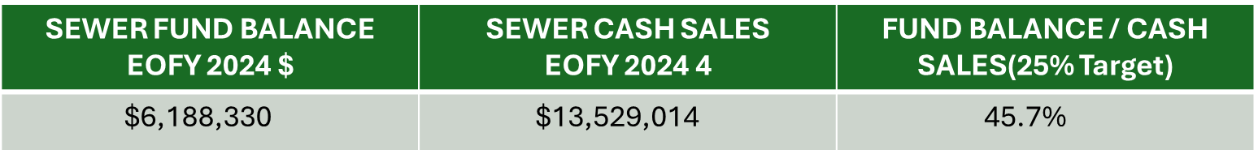
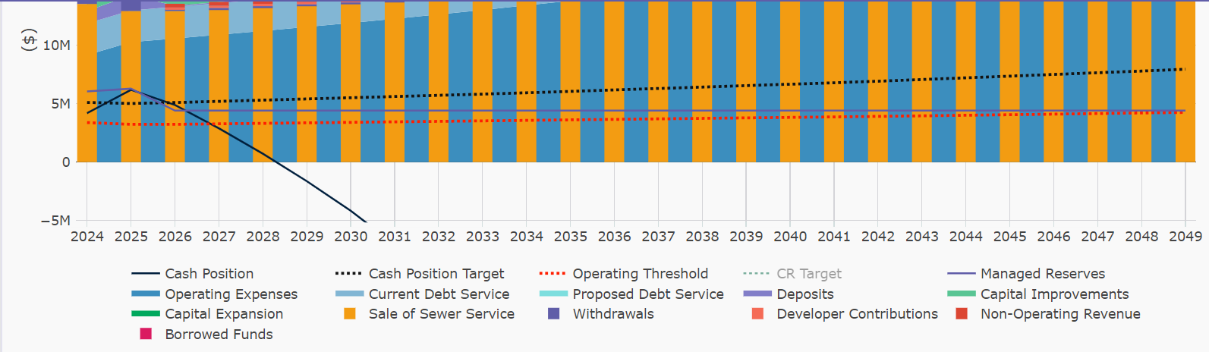
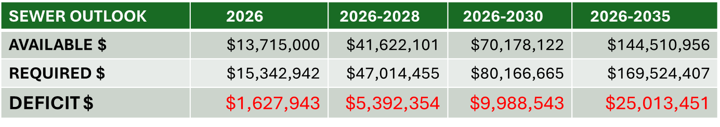
SEWER LONG TERM FINANCIAL MODEL
(SLTFM) STRATEGY
$
FY2025 sewer rates cannot support the capital that is needed to replace assets .
The funding shortfalls for 1 yr, 3 yrs, 5 yrs and 10 yrs are as shown in the table
FUND BALANCE CASH POSITION

Slide 17
SEWER LONG TERM FINANCIAL MODEL
(SLTFM) STRATEGY
EOFY2024 FUND BALANCE = $6,188,630
EOFY2025 FUND BALANCE = $6,388,630
LOWER THRESHOLD 25% = $3,382,000
Fund balance will reduce by $6.4M in FY2025.
SALES GROWTH = 1.90% / YR.
-$1,300,000 PER FY2025 BUDGET
+1,500,000 RETURN CITY FARM TO CASH REVENUE STATUS
NON-SALES REVENUE = $411,000 / YR.
EXPENSE INFLATION = 5.0% / YR.
CAPITAL ACSO = $2,056,932+ / YR.-- CIP
CAPITAL EXPANSION BY DEBT $0M

Slide 18
SEWER LONG TERM FINANCIAL MODEL
(SLTFM) STRATEGY
EOFY2024 FUND BALANCE = $6,188,630
EOFY2025 FUND BALANCE = $6,388,630
LOWER THRESHOLD 25% = $3,382,000
A sales growth of 1.9% is forecasted.
SALES GROWTH = 1.90% / YR.
NON-SALES REVENUE = $411,000 / YR.
EXPENSE INFLATION = 5.0% / YR.
CAPITAL ACSO = $2,056,932+ / YR.-- CIP
CAPITAL EXPANSION BY DEBT $0M

Slide 19
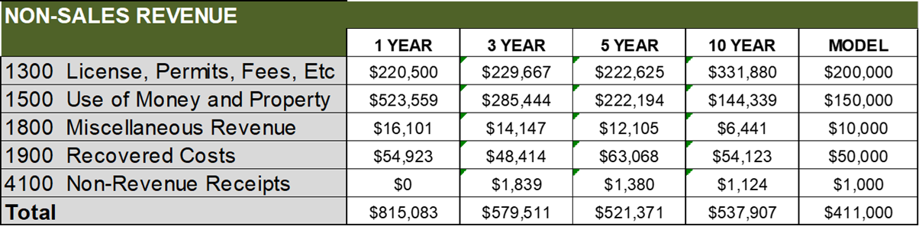
SEWER LONG TERM FINANCIAL MODEL
(SLTFM) STRATEGY
EOFY2024 FUND BALANCE = $6,188,630
EOFY2025 FUND BALANCE = $6,388,630
LOWER THRESHOLD 25% = $3,382,000
This non-sales revenue is volatile in historic trending, and we therefore forecast $411,000 per year with zero inflation.
SALES GROWTH = 1.90% / YR.
NON-SALES REVENUE = $411,000 / YR.
EXPENSE INFLATION = 5.0% / YR.
CAPITAL ACSO = $2,056,932+ / YR.-- CIP
CAPITAL EXPANSION BY DEBT $0M

Slide 20
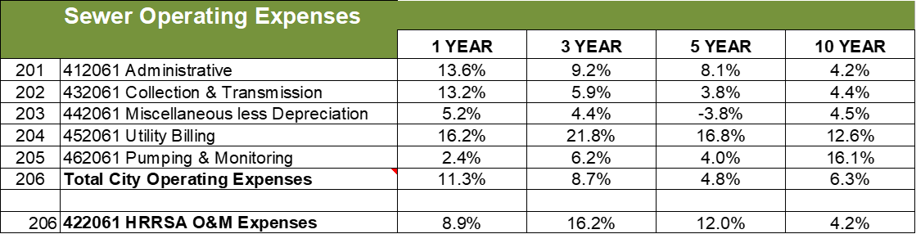
SEWER LONG TERM FINANCIAL MODEL
(SLTFM) STRATEGY
EOFY2024 FUND BALANCE = $6,188,630
EOFY2025 FUND BALANCE = $6,388,630
LOWER THRESHOLD 25% = $3,382,000
SALES GROWTH = 1.90% / YR.
NON-SALES REVENUE = $411,000 / YR.
EXPENSE INFLATION = 5.0% / YR.
CAPITAL ACSO = $2,056,932+ / YR.-- CIP
We forecast a 5.0% per year operating expense inflation.
CAPITAL EXPANSION BY DEBT $0M

Slide 21
SEWER LONG TERM FINANCIAL MODEL
(SLTFM) STRATEGY
EOFY2024 FUND BALANCE = $6,188,630
EOFY2025 FUND BALANCE = $6,388,630
LOWER THRESHOLD 25% = $3,382,000
911161 | ACSO FUND CODE | CARV | ACSO
48641 | Blacks Run Interceptors | $50,881,206 | $102,859
48735 | Collection | $268,394,362 | $1,490,034
 | I&I |  | $200,000
48736 | Pumping | $1,864,624 | $41,527
48734 | Metering | $3,179,679 | $62,512
 | SUBTOTAL UTILITIES | $324,319,871 | $1,896,932
48740 | IT
48757 | Facilities | $10,000,000 | $10,000
 | Total | $334,319,871 | $1,906,932
SALES GROWTH = 1.90% / YR.
NON-SALES REVENUE = $411,000 / YR.
EXPENSE INFLATION = 5.0% / YR.
CAPITAL ACSO = $2,056,932+ / YR.-- CIP
ADD:
$50k / YR MAIN EXTENSIONS
$100K – WOC THRU 2034
We forecast $2,056,932 per year needs in capital less $250K per year in contributions made from construction.
CAPITAL EXPANSION BY DEBT $0M

Slide 22
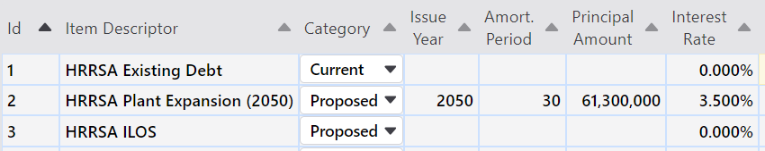
SEWER LONG TERM FINANCIAL MODEL
(SLTFM) STRATEGY
EOFY2024 FUND BALANCE = $6,188,630
EOFY2025 FUND BALANCE = $6,388,630
LOWER THRESHOLD 25% = $3,382,000
SALES GROWTH = 1.90% / YR.
NON-SALES REVENUE = $411,000 / YR.
EXPENSE INFLATION = 5.0% / YR.
Note:
Per HRRSA ILOS strategy, new debt is added equal to the amount of existing debt that is scheduled to retire.
CAPITAL ACSO = $2,056,932+ / YR.-- CIP
CAPITAL EXPANSION BY DEBT $0M

Slide 23
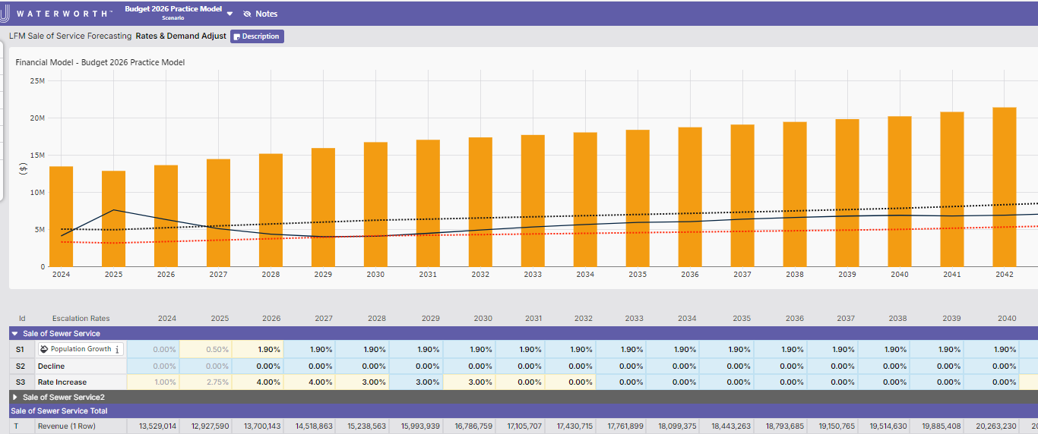
SEWER LONG TERM FINANCIAL MODEL
(SLTFM) STRATEGY
RATE INCREASES
2026-2027 4.0%
2028-2030 3.0%
FUND BALANCE CASH POSITION

Slide 24
Water & Sewer Rate Structuring for Affordability

Slide 25
Water & Sewer Rate Structuring for Affordability
#1 What revenue goals and pricing to apply to non-Owner customers (rural & wholesale customers)
#2 What methodology to apply for distributing cost among the customers
a) Allocation in proportion to origin of cost (AWWA Cost of Services)
b) Progressive versus Regressive Rates
Progressive rates-favor affordability toward lower income customers by shifting the burden away from conservative users and toward higher volume users.
Lower fixed costs such as minimums or base rates (places higher revenue uncertainty on the utility)
Uniform or inclining block rate structures.
Increases to existing rates by uniform percentage versus uniform unit price.
May make provisions based on Household Medium Income (HMI), 20% of Household Medium Income (AR20), or Household Minimum Wage Income (HM).
Regressive rates- opposite of progressive rates and pursue security of revenue for the utility.

