Slide 1
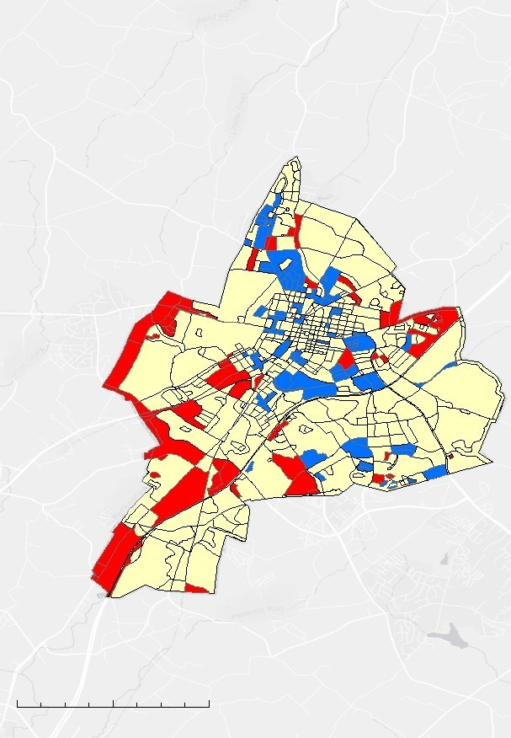
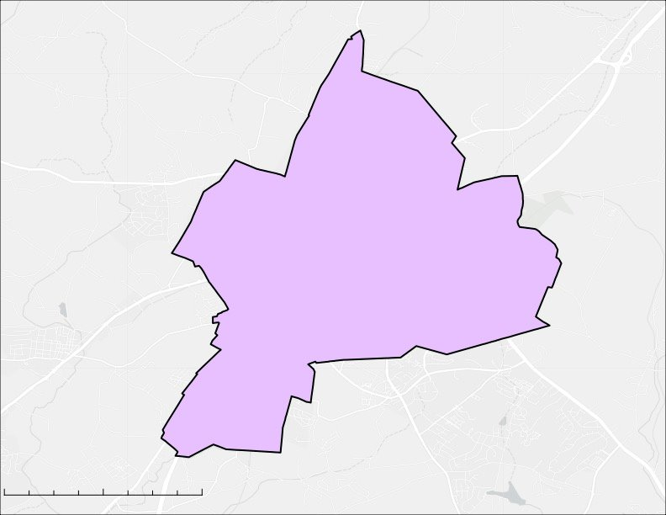
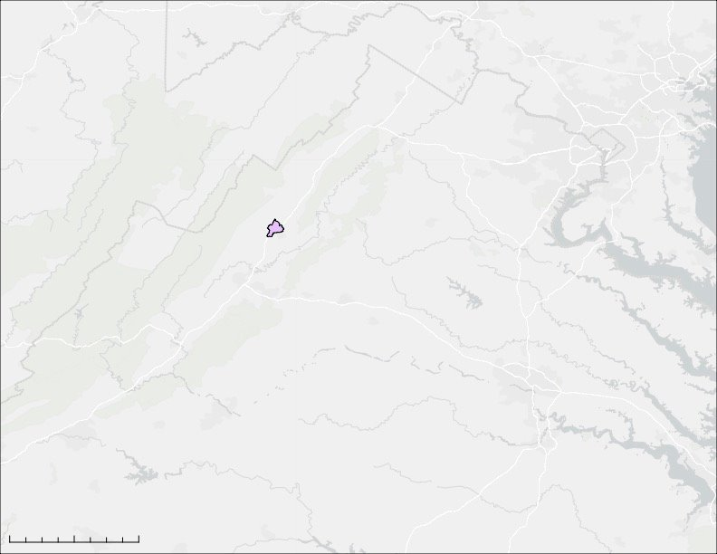

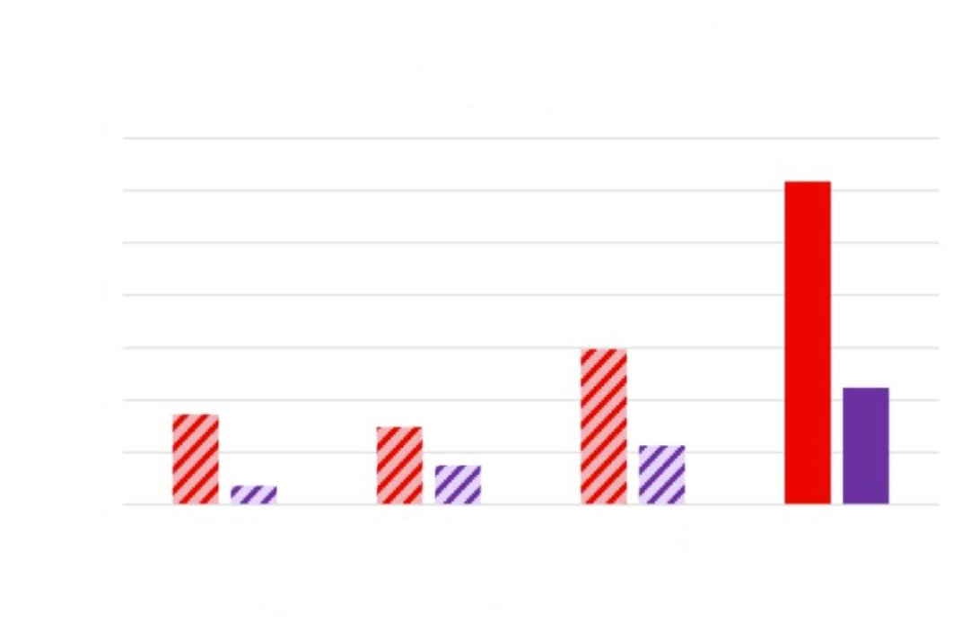
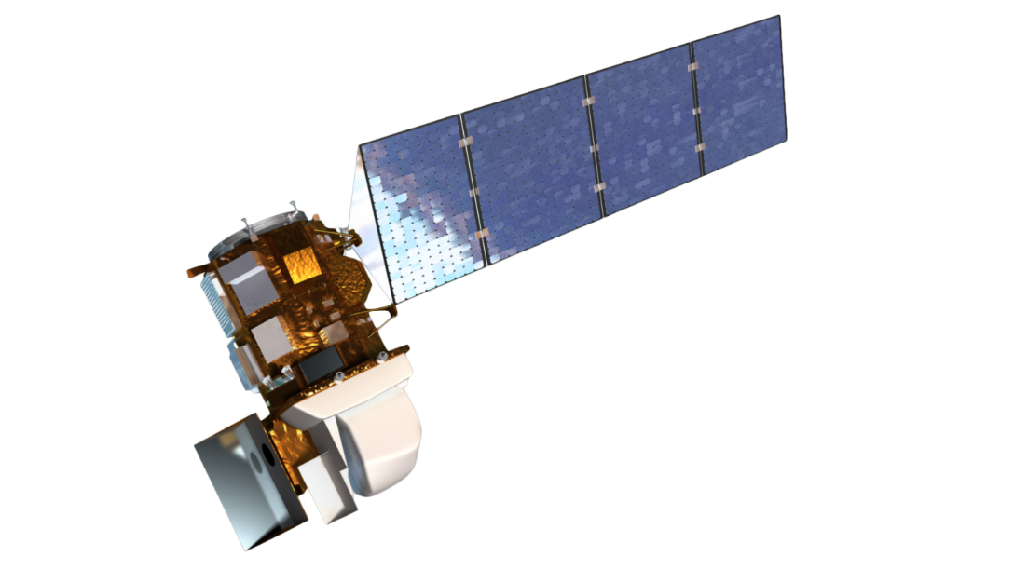






Harrisonburg Health & Air Quality
Assessing Land Change and Urban Heat Islands for Future Tree Planting in Harrisonburg, Virginia
Project Synopsis
Methodology
The City of Harrisonburg, Virginia has experienced a 617-acre loss in tree canopy cover from 2014 – 2023 largely due to the arrival of the emerald ash borer, a pest that feeds on species of ash trees. An increase in development within the city also contributed to loss of tree canopy and an increase in impervious, heat-absorbing surfaces. This project aimed to determine the feasibility of using NASA Earth observations to assess changes in Harrisonburg’s urban tree canopy from 2014 and 2023 and identify potential areas for future tree planting. The findings will support the City of Harrisonburg Public Works Department’s urban forestry planting initiatives to reduce ambient temperatures and better manage stormwater.
Earth Observations
Landsat 8 TIRS & Landsat 9 TIRS-2 (LST)
NAIP (Land cover change)
Data Processing
Calculate LST in ArcGIS Pro using Raster Calculator
Object-based Classification in ArcGIS Pro: “Canopy,” “Grass,” and “Development”
Objectives
Data Analysis
Overlay Virginia census block data to calculate mean LST for each block between 2014 – 2024
Conduct change detection analysis to quantify pixels changed between classes over four-time intervals
Map land surface temperature (LST), hot spots, tree cover, and impervious surfaces
Quantify change in tree canopy and impervious surface over time
Identify potential areas for future tree planting
Results
Changes in LST by Census Block 2014 – 2023
Canopy Decrease and Impervious Surface Increase
2014 – 2023
Side-by-side comparison of LST change (left) and land cover change (right) from 2014 – 2023 in Harrisonburg. This visual comparison demonstrates the association with changes in LST and changes in land cover.
Study Area
WEST VIRGINIA
HARRISONBURG
Canopy decrease
N
Increase in rank by LST
0
1 mile
Canopy decrease
0
5
10 miles
No change in rank by LST
0.5
Impervious surface increase
RICHMOND
Basemap: Esri, TomTom, Garmin, FAO, NOAA, USGS, © OpenStreetMap contributors, and the GIS User Community​
0
0.5
1 mile
Decrease in rank by LST
N
0
0.5
1 mile
VIRGINIA
N
Basemap: Esri, TomTom, Garmin, FAO, NOAA, USGS, © OpenStreetMap contributors, and the GIS User Community
Canopy Decrease vs. Impervious Surface Increase, 2014 – 2023
0
25
50 miles
Harrisonburg experienced a 617-acre decrease in tree canopy and a 224-acre increase in impervious surfaces during the study period. The bulk of canopy loss and development occurred from 2021 – 2023.
700
Earth Observations
600
500
Acres
400
300
200
100
0
2014 – 2016
2016 – 2021
2021 – 2023
2014 – 2023
Conclusions
Canopy Decrease
Impervious Increase
Landsat 8 TIRS
Landsat 9 TIRS-2
Remote sensing is a feasible method for quantifying change in LST and land cover over time, as it allows for change detection over large areas.
90 out of 646 census blocks had an LST increase during the study period.
Identified hotspots and areas of low canopy cover will allow partners to prioritize tree planting in areas most susceptible to heat and flood-related disasters.
Project Partners
City of Harrisonburg, Public Works Department
Team Members
Acknowledgements
City of Harrisonburg Public Works: Jeremy Harold, Brittany Clem-Hott, Shayna Carter, Tom Hartman, Mike Hott, and Keith Thomas
James Madison University: Dr. Xiaojing Tang, Lead Science Advisor
Virginia – Langley: Ella Haugen, Pop-Up Project Lead
Alexander Temoshok
Benjamin Lengane
Emma Holm-Olsen
Riley Barlett
Pop-Up Project – James Madison University | Spring 2025​

